Slide 1


AI and the Business Gold Rush
Dr. Jim Hoover
Director, Business Analytics and Artificial Intelligence Center
Warrington College of Business
University of Florida hooverjh@ufl.edu 352-294-0410
Gator Club of Ponte Vedra
6/20/2024

Slide 2
What is AI?
AI is a machine’s ability to perform cognitive functions we associate with human minds. This includes functions like perceiving, reasoning, learning, interacting with an environment, and even exercising creativity.¹
Artificial Intelligence
Machine learning (ML) is a subfield of artificial intelligence (AI) that focuses on the development of algorithms and statistical models that enable computers to perform tasks by learning from data, rather than being explicitly programmed for each specific task.²
Machine Learning
Deep Learning
Deep learning is a subset of machine learning that involves the use of artificial neural networks with multiple layers to progressively extract higher-level features from raw input.³
GPTs
GPTs, or Generative Pre-trained Transformers, are a family of neural network models that use the transformer architecture.⁴ Sometimes these models are call Large Language Models (LLMs) or Foundation Models.
McKinsey – Hyperlink
IBM - Hyperlink
3. IBM – Hyperlink
4. Amazon AWS - Hyperlink

Slide 3

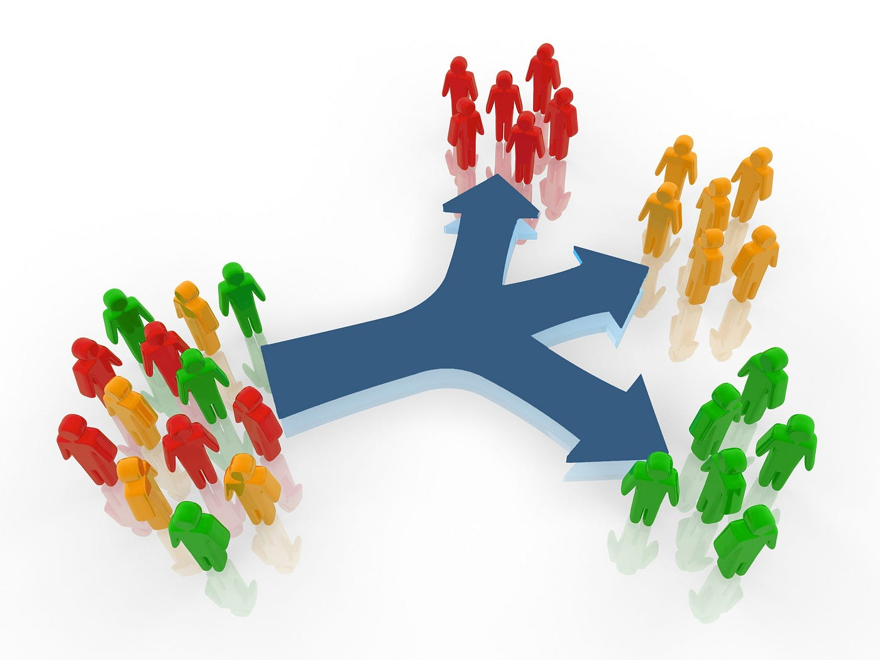
Major Machine Learning Types – Unsupervised Learning
Example – Customer Profiling
No label in your data
Data includes customer characteristics
Uses similarity to group customers
Hyperlink to image source - Medium

Slide 4
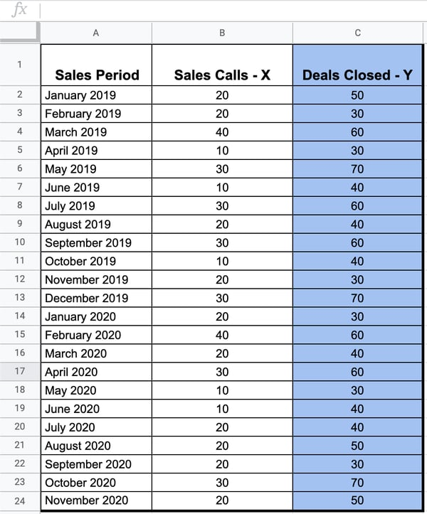
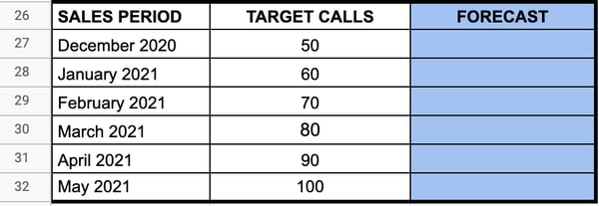
Machine Learning Types – Supervised Learning
Hyperlink to article with images - Hubspot
Example – Numeric Prediction Models
You try to predict a number (e.g., deals closed)
Data includes past sales to use for training
Data also includes predictor variables (e.g., marketing effort)
Model created is applied to new predictor variables
Training Data
Predictions

Slide 5

Machine Learning Types – Supervised Learning
Hyperlink to article with image - Google
Example – Classification Prediction Models
You try to predict classes or categories (e.g., will purchase an item or not)
Data includes known previous categories
Data also includes predictor variables (e.g., customer characteristics)
Model created is applied to new predictor variables
Training Data
Predictions
Classification Model
Someone must identify previous spam emails
Data includes email characteristics

Slide 6

Machine Learning Types – Reinforcement Learning
Example – Reinforcement Learning Models
You try to optimize the input variables (e.g., the speed) to achieve an objective (e.g., to win the race)
Inputs measured along with environment (where are you on the track and at what speed) along with the outcomes

Slide 7
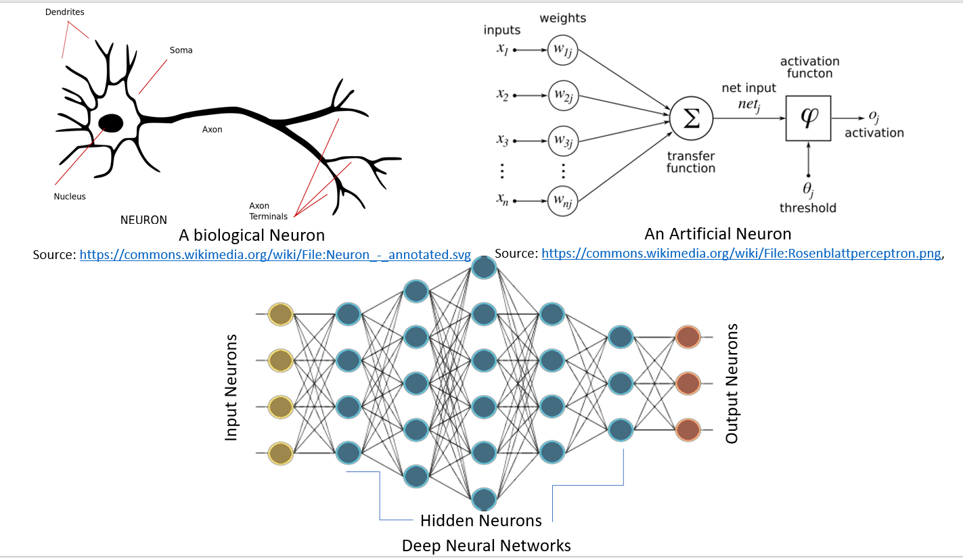
Deep Learning… Neural Networks
Neural networks thought to mimic the human brain
Artificial Neural Networks and the activation function
Deep Neural Networks use multiple layers of hidden nodes (i.e., Neurons)
Hyperlink to image source – packt article
Neural Networks can be used for either numeric prediction or classification.
Neural networks require labeled data to train.
~ 100B neurons in the human brain
Input variables
Output Predictions

Slide 8
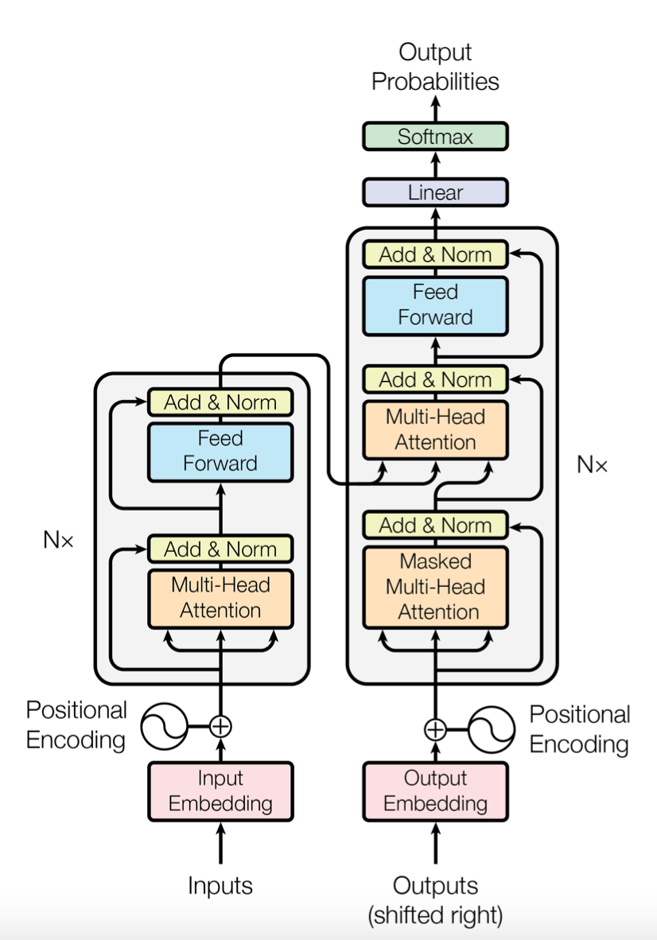
Generative AI
Attention Is All You Need
GPTs
Also referred to as Foundation Models or Large Language Models (LLMs)
They are sophisticated neural networks that tie together multiple steps and neural networks
Uses the transformer architecture
Attention Is All You Need paper by Google scientists (2017)
Requires a lot of data to train successfully
ChatGPT architecture is more sophisticated
It also includes reinforcement learning (RLHF)
Hyperlink to image source – Google paper

Slide 9
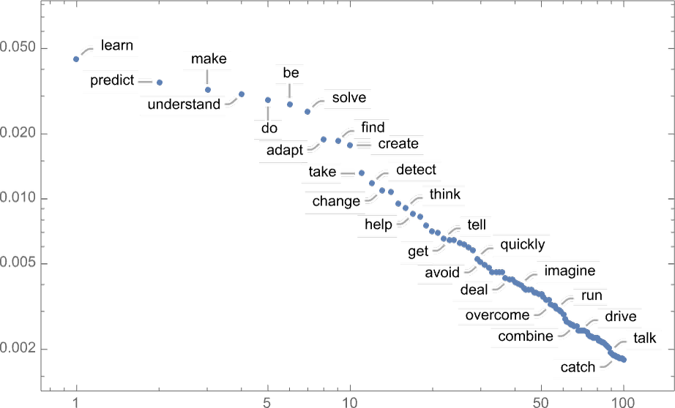
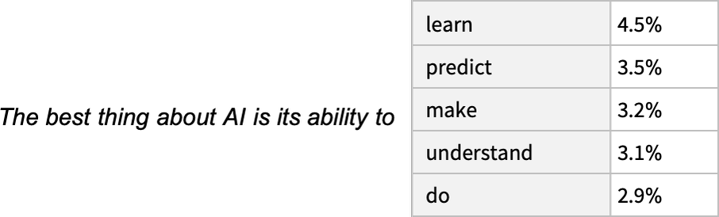
Generative AI
How do large language models work?
By predicting the next word or symbol in a sequence based on the neural network training and the probability of occurrence of the next word.
“Temperature” changes which probability is selected.
Words
Probabilities
“Given the text so far, what should the next word be?”
Hyperlink to images source – Woldfram article

Slide 10
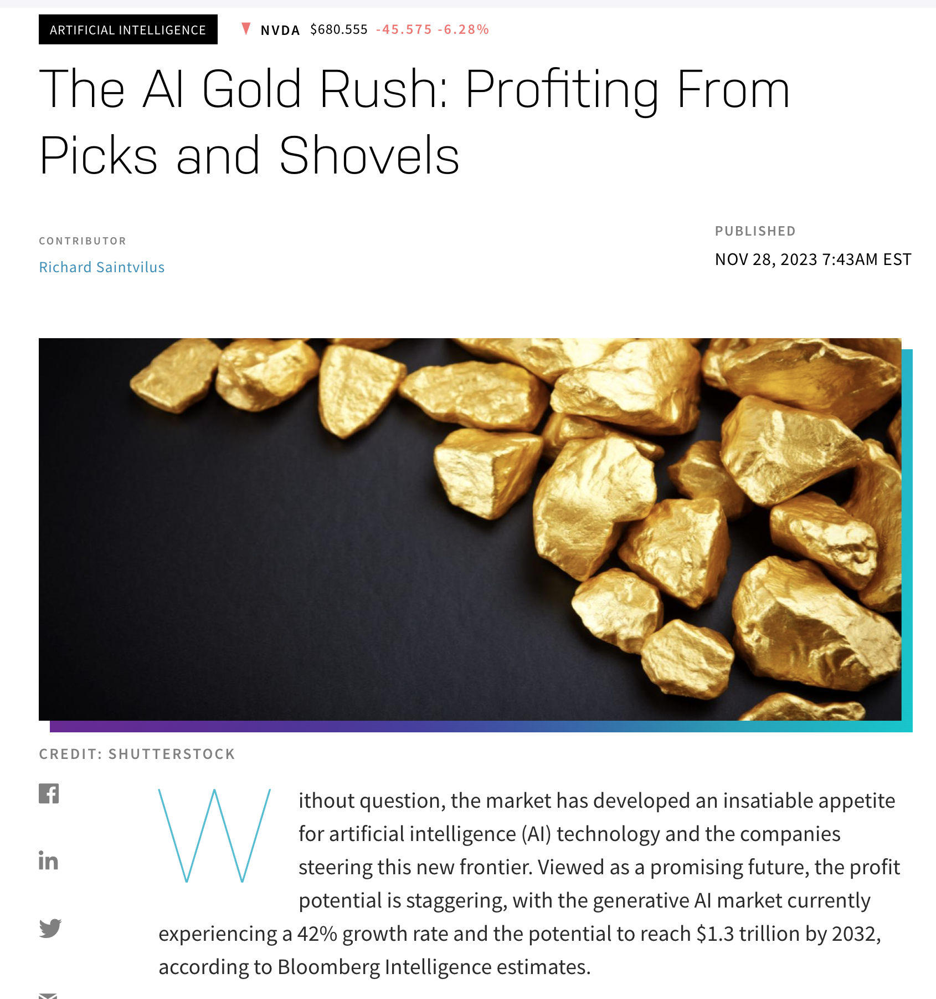
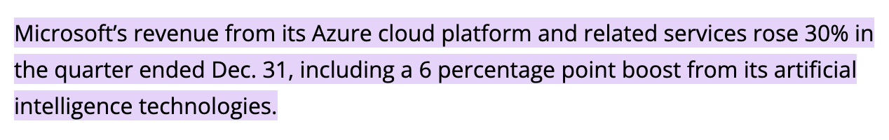
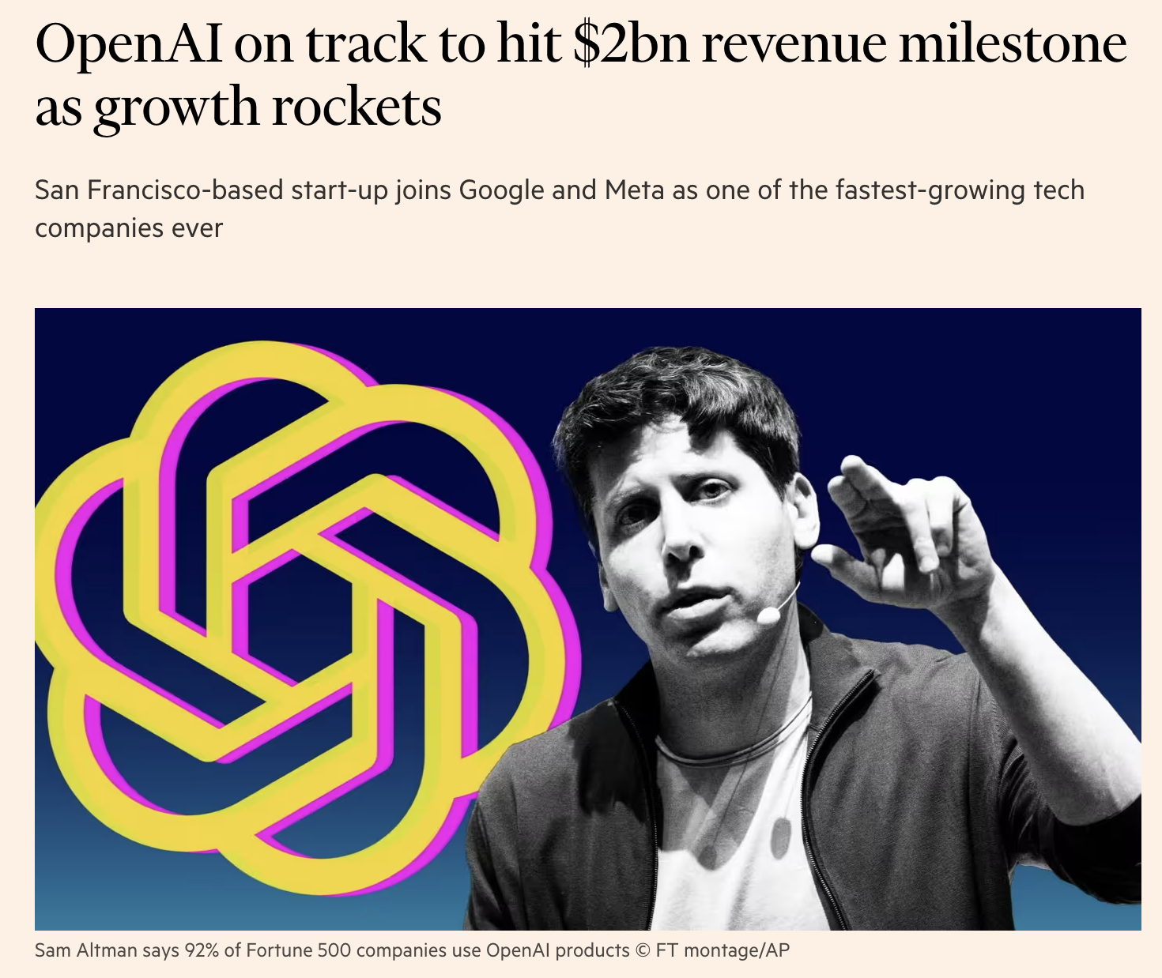
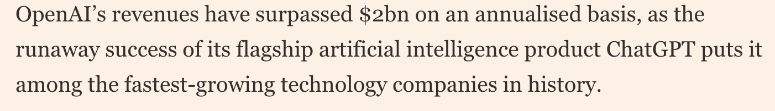
The AI Business Gold Rush
Hyperlink to image source – NASDAQ
Microsoft – Feb 2024 Earnings

Slide 11
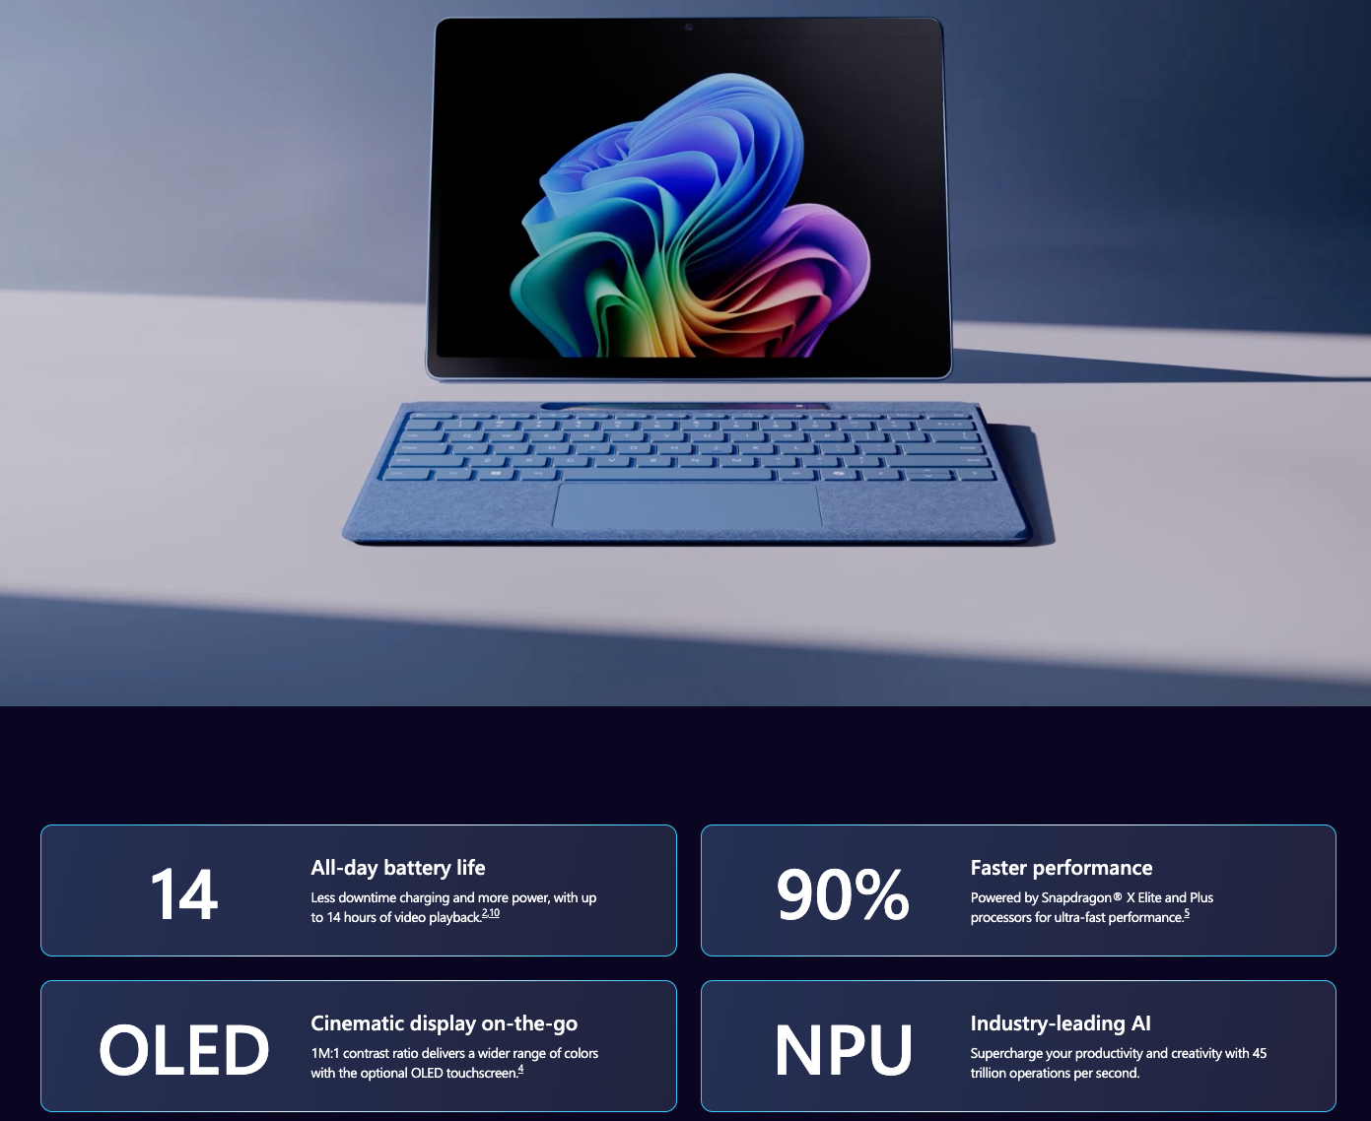
The AI Business Gold Rush
https://www.microsoft.com/en-us/surface/devices/surface-pro-11th-edition

Slide 12
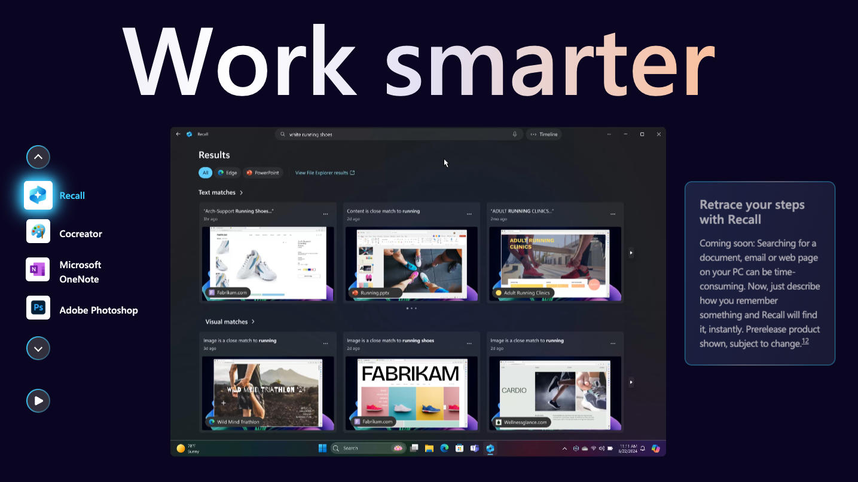
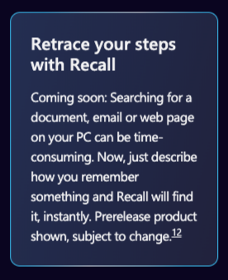
The AI Business Gold Rush
https://www.microsoft.com/en-us/surface/devices/surface-pro-11th-edition

Slide 13
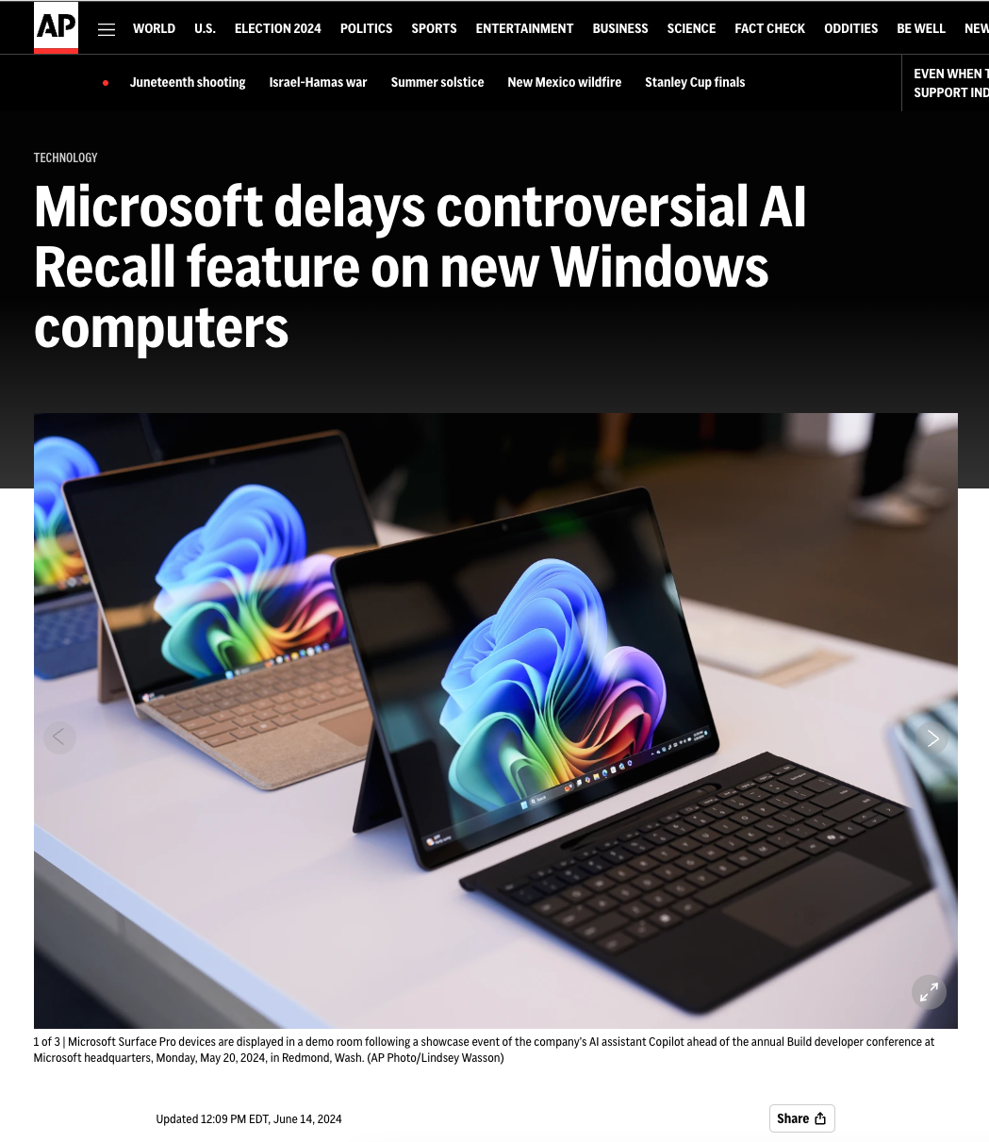
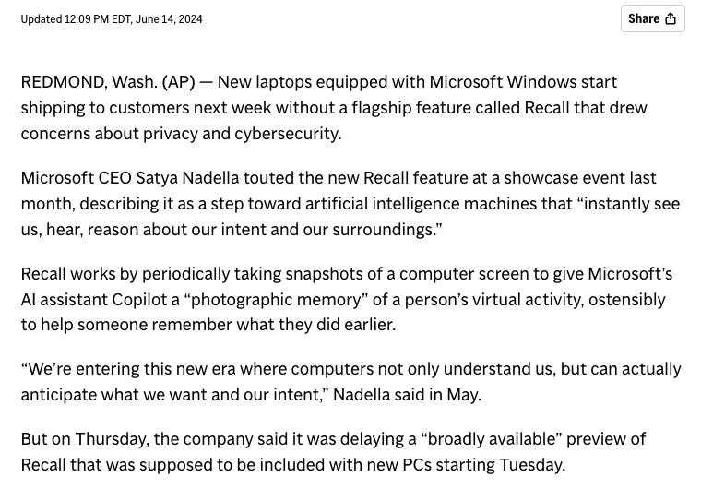
The AI Business Gold Rush
Hyperlink

Slide 14
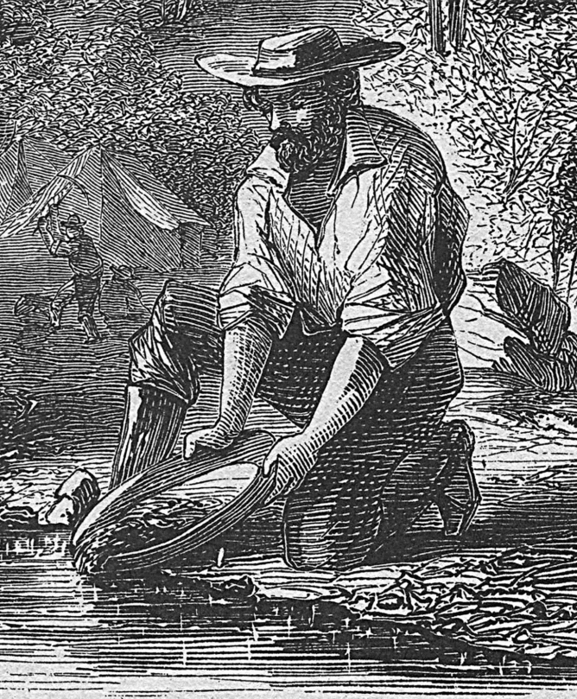
The AI Business Gold Rush
What are CEOs using ChatGPT / Gen AI to do?
Primarily creative actions (particularly for marketing)
Ad Copy
SEO
Software coding assistance
Images for marketing
Marketing campaign ideas
Some are saying they are laying off white collar workers as a result
By one tracker, US firms have announced 4,600 job cuts since May related to artificial intelligence. Source Bloomberg (2/8/24)
But many of these layoffs are of others in order to hire AI workers
How are You using or planning to use Gen AI?

Slide 15

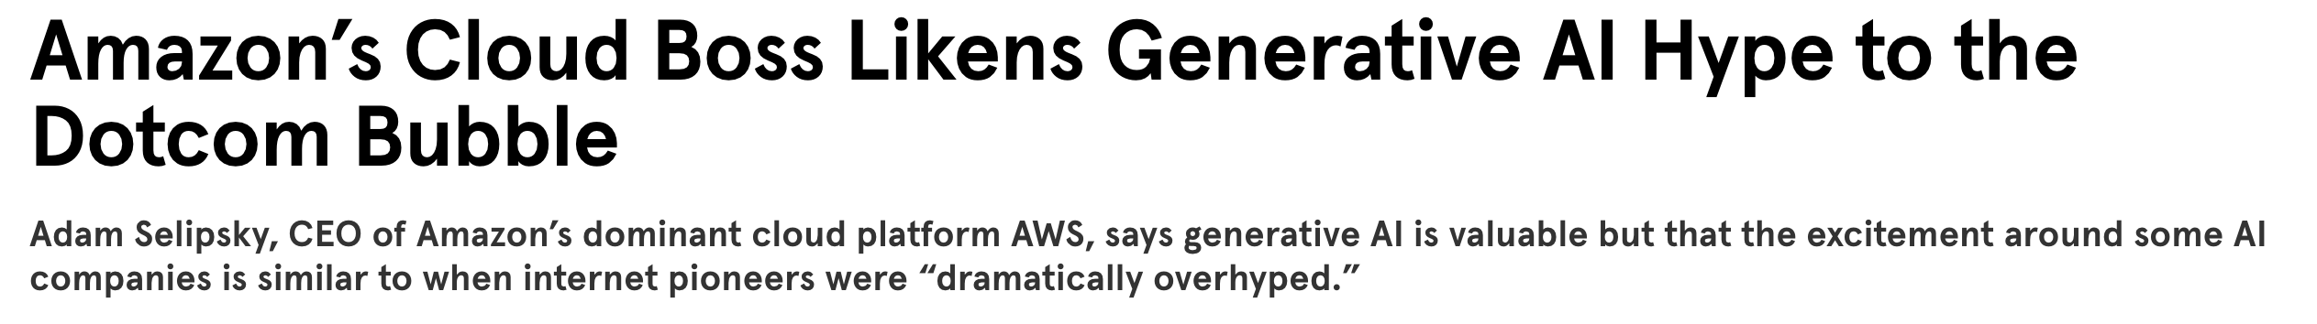
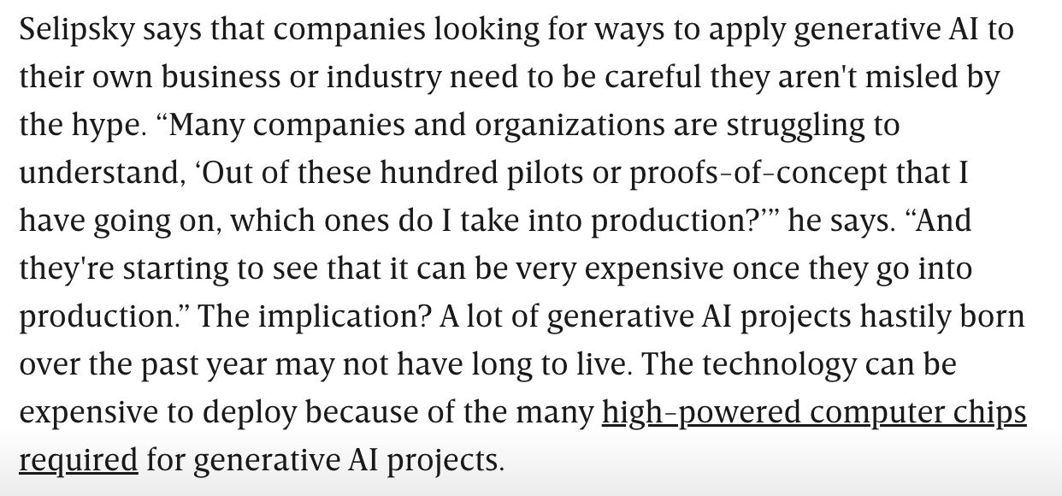
Is the Gold Rush for Gen AI a Bubble?
Similar to the dot-com bubble?
Like other business fads?
Some companies will be disappointed
Some will invest in the wrong technologies
Some will fail to see the return on investment
Hyperlink to Article on Wired

Slide 16
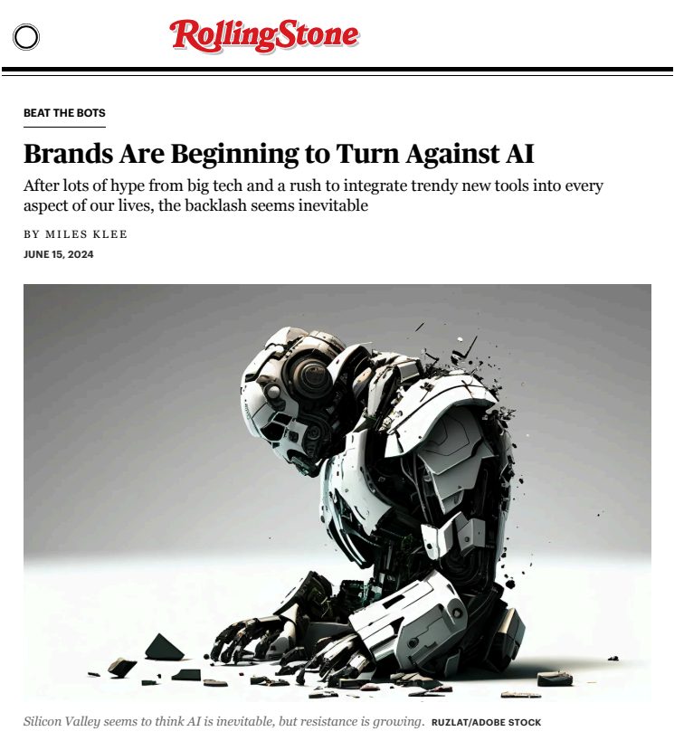
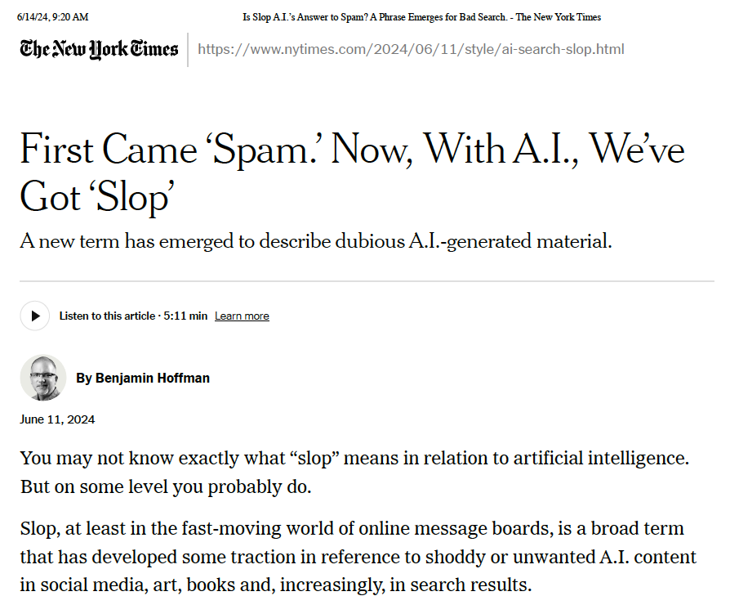
Is the Gold Rush for Gen AI a Bubble?

Slide 17
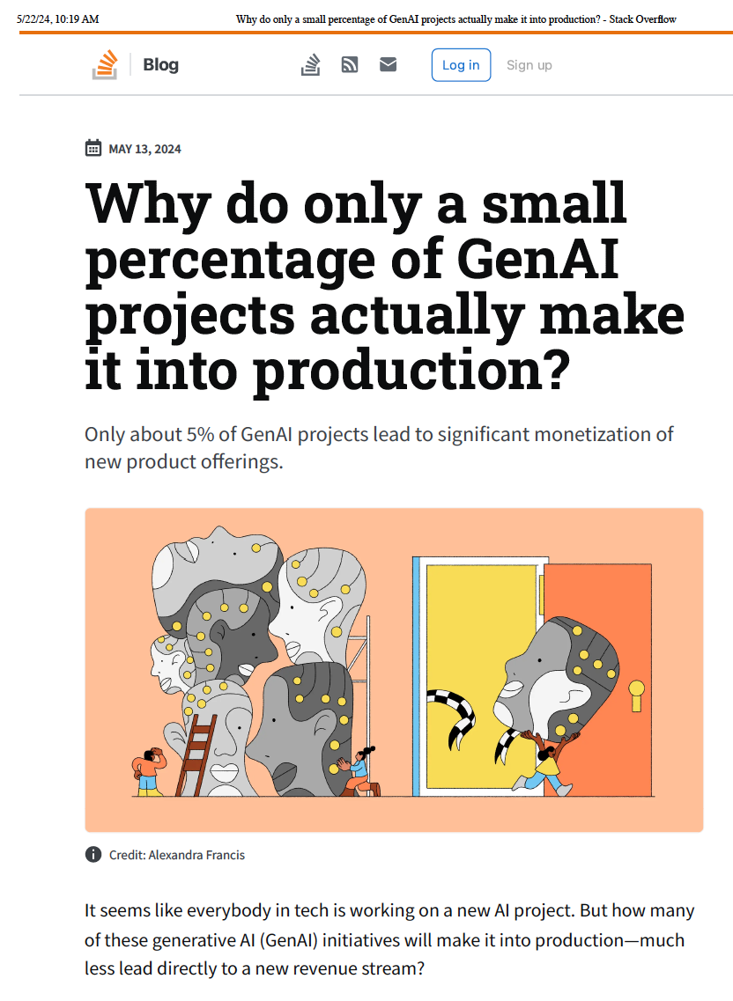
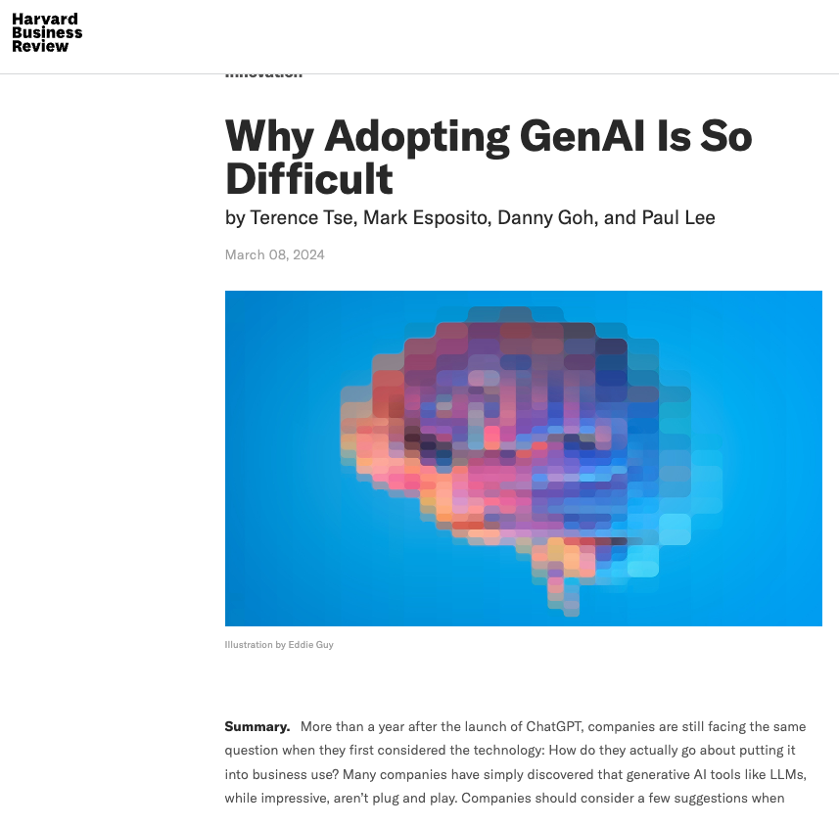
Is the Gold Rush for Gen AI a Bubble?
Hyperlink
Hyperlink

Slide 18
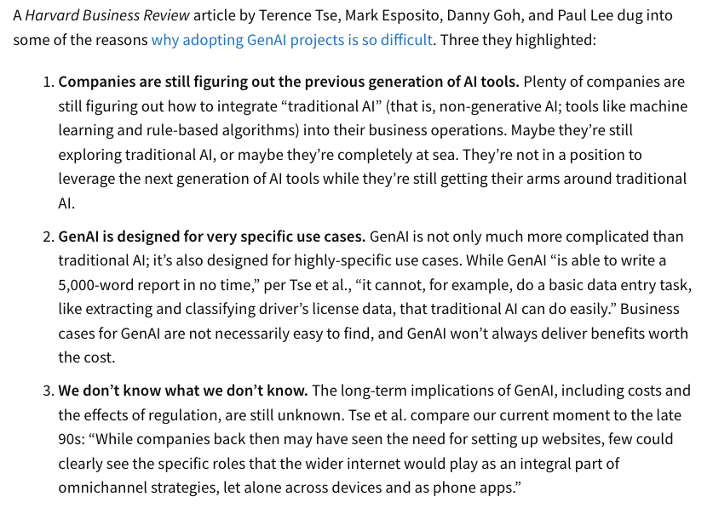
Is the Gold Rush for Gen AI a Bubble?
Hyperlink
Hyperlink

Slide 19
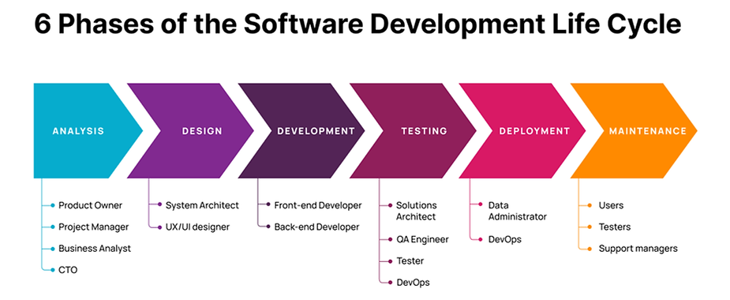
Risks – Aligning Gen AI Solutions with IT Development
Image source – Medium
How long is your software development life cycle?
What is your release schedule?
Even with Agile SDLC, it can be challenging to match the innovation cycle and deprecation pace for Gen AI.
After development, how long before your product no longer works?
Cloud-based or internal GPTs may provide longer effective software lifetimes
While this may increase ROI on the development, it may come at the cost of slower capability integration

Slide 20
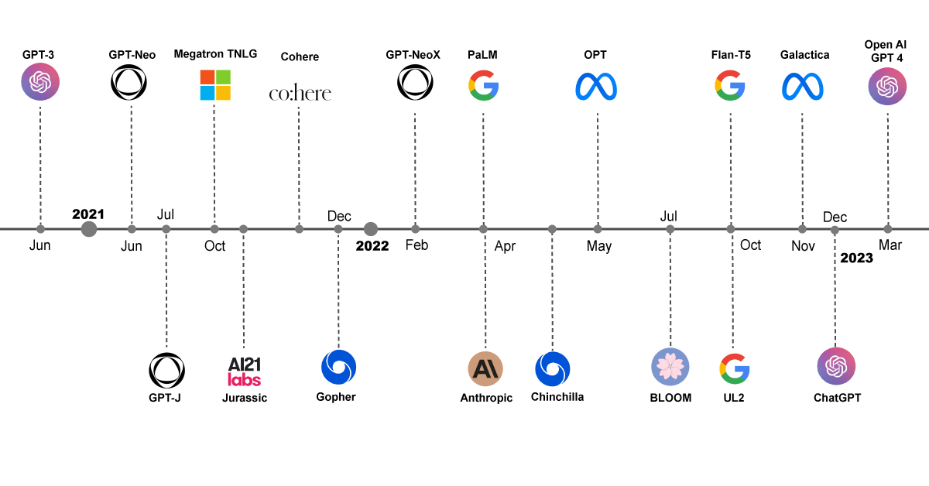
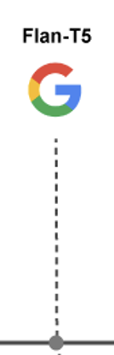




Risks – Rapidly Changing Capabilities & Players
Gemini
Mar
Nov
Nov
2023
2024
CoPilot
OpenAI
GPT4-
Turbo
Modified version of source image - Hyperlink

Slide 21
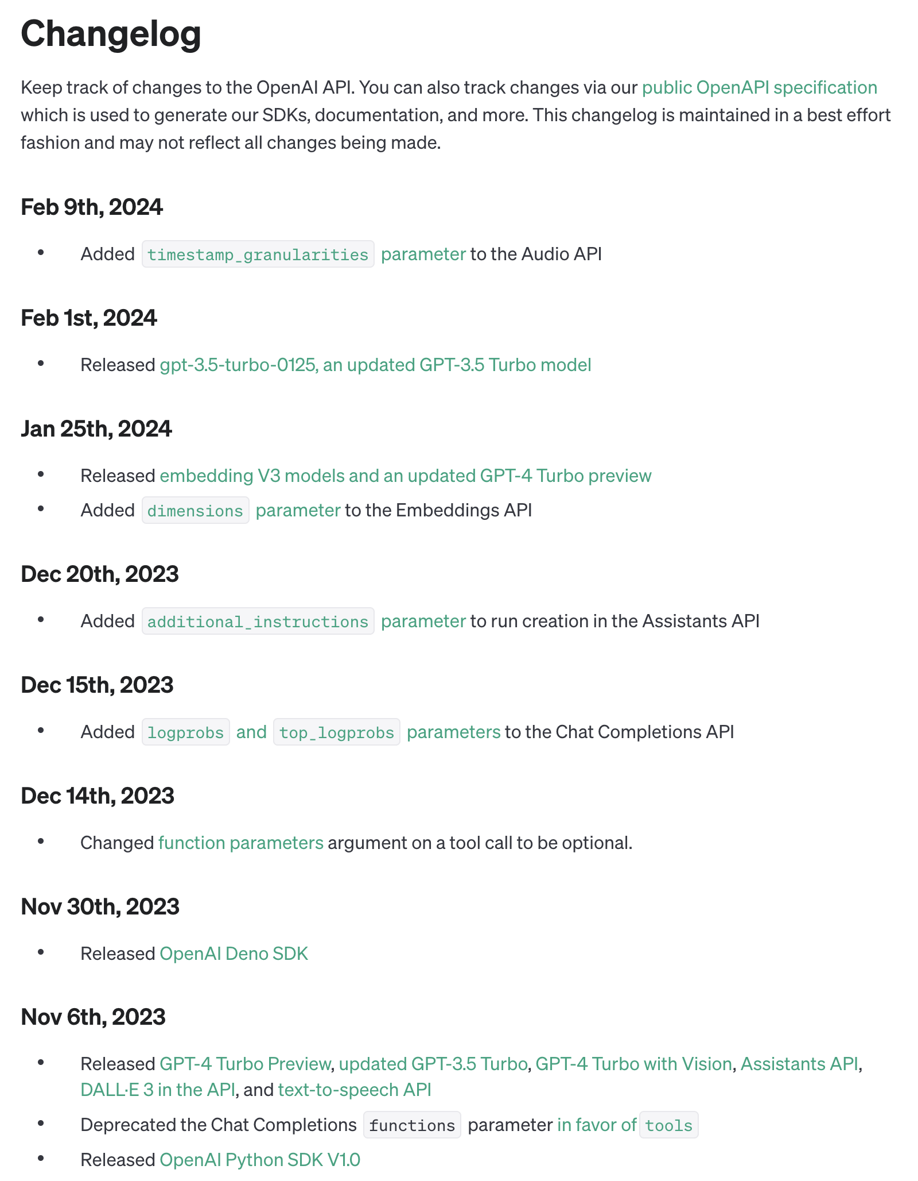
Risks – Rapidly Changing Capabilities & Players
Changes occurring very rapidly
Deprecation of functions and capabilities
Model changes
Bug fixes
Implications for integration into software development efforts
x
Changelog from OpenAI - Hyperlink

Slide 22
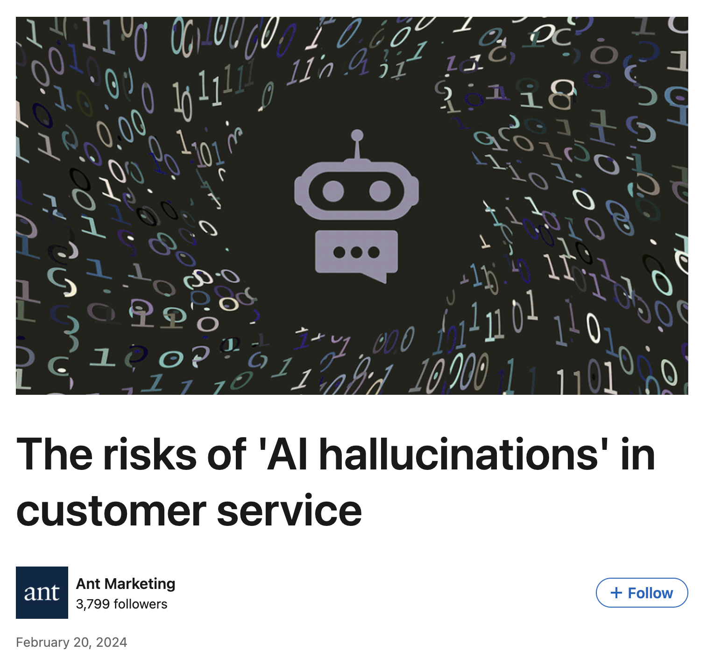
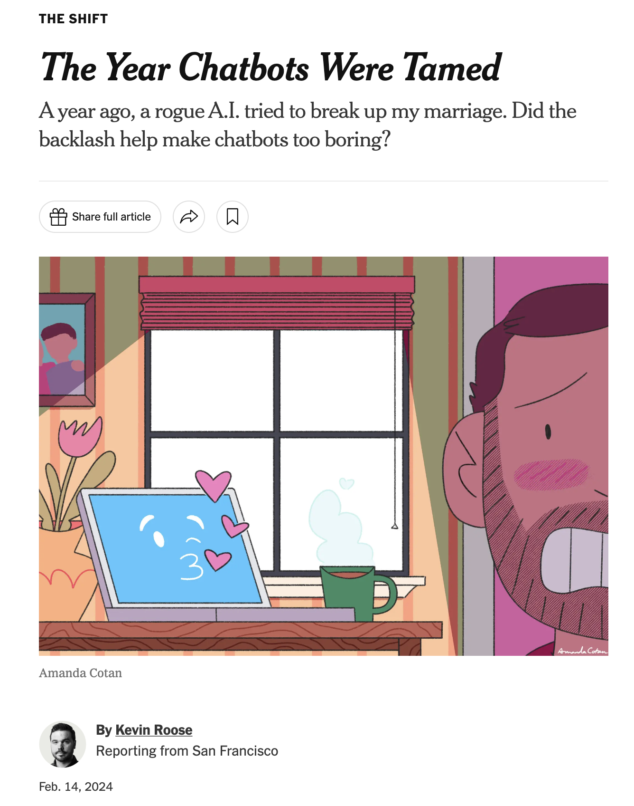
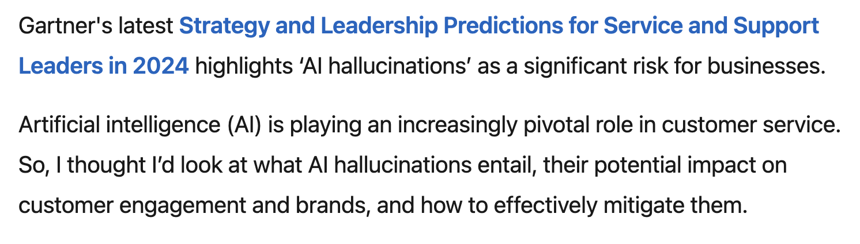
Risks – Hallucinations
Article about Microsoft’s Sydney AI – NYT Article
Impacts on Business Applications of AI – Ant Marketing Article

Slide 23
Risks – Aligning Gen AI Projects with Capabilities
Good at:
Administrative tasks
Content generation
Coding assistance
Effective customer communication
Multilingual communication and translation
Strategy outlining
Audio, Video, and Image generation
Not Good at:
Always providing truthful answers
Negotiation
Identifying when it is being manipulated
Lack of true emotional intelligence
Providing details aligned with strategy recommendations
Concepts modified from - Hyperlink

Slide 24
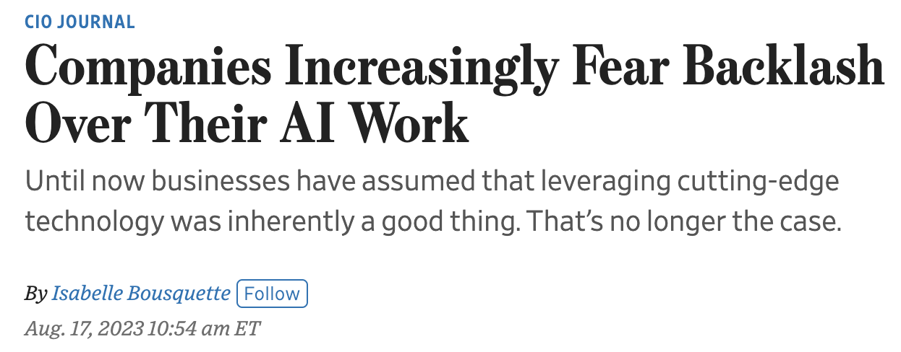
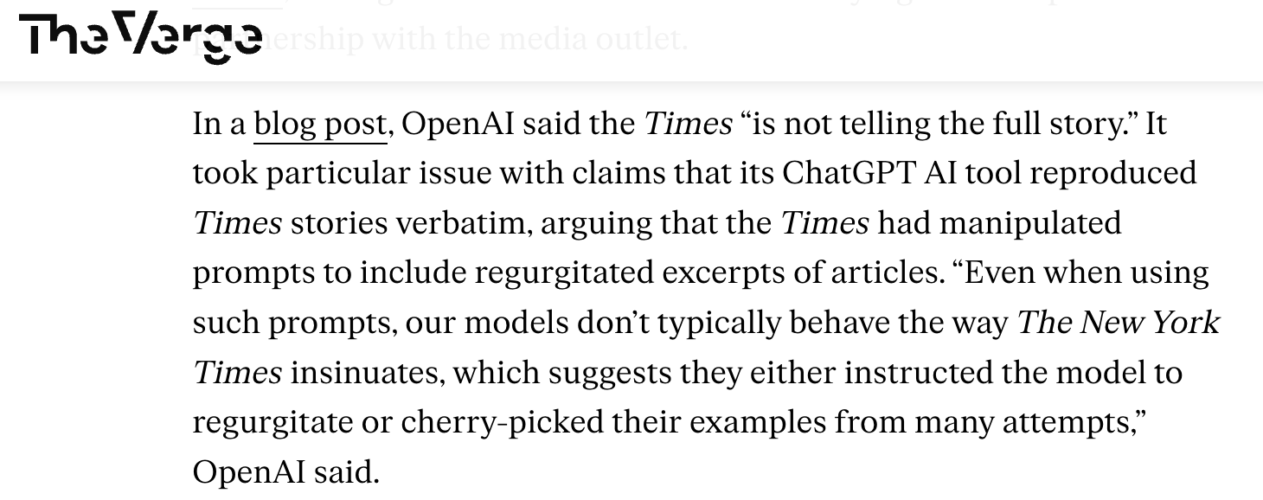
Risks – Ethics and Gen AI
Training data
Copyrighted content
Harmful content
Amplification and perpetuation of existing biases
Caused by training data
Providing inaccurate responses
Providing inaccurate references or attribution
Reliance on AI answers
Impact on humans
WSJ Article on this topic - Hyperlink
The Verge article on the NYT copyright suit - Hyperlink
List modified from this article - Hyperlink

Slide 25
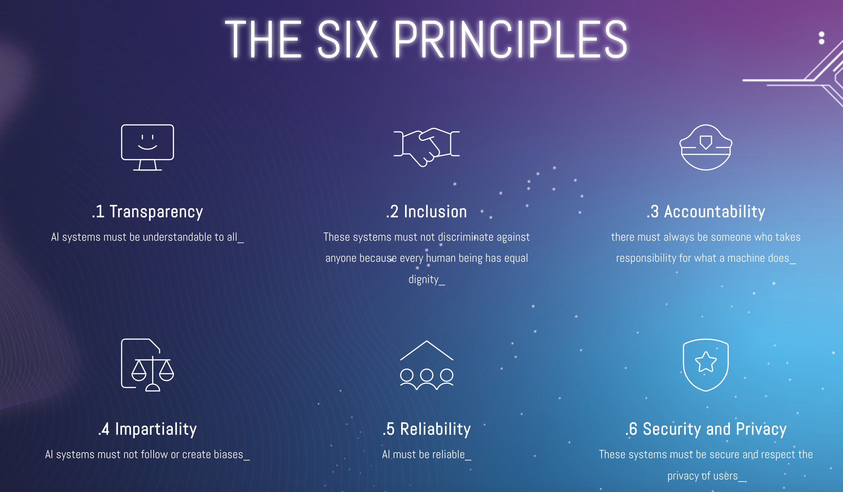
Risks – Ethics and Gen AI
The Rome Call for AI Ethics - Hyperlink

Slide 26


Risks – Regulation and Gen AI
Executive Order on Trustworthy AI - Hyperlink

Slide 27
Improving Probability of Good Gen AI Project Outcomes
The “5% better rule”
Evaluating opportunities
IT Cost, schedule and likelihood of good outcomes
Time to return evaluation
Future-proofing your investments
Training your workforce
Using the system
Assessing the accuracy of output (see hallucinations)

Slide 28
Improving Probability of Good Gen AI Project Outcomes
Mitigate legal and regulatory issues
What data was used to train your Gen AI solution?
What happens if you lose access to your built solution due to legal or regulatory issues with your Gen AI provider?
Put in place “guardrails” for when and how your people can use Gen AI
If you can, develop a risk plan associated with Gen AI projects and solutions

Slide 29
Improving Probability of Good Gen AI Project Outcomes
Mitigate Rate of Change Issues
Align your Gen AI solution with a trusted provider
OpenAI turmoil over leadership and direction
Longevity
Consider cloud implications
Cost
Longevity
Place bets with companies likely to survive in the long run

Slide 30
Copy of the Presentation on GitHub
Presentation Location

Slide 31
Backup Slides

Slide 32
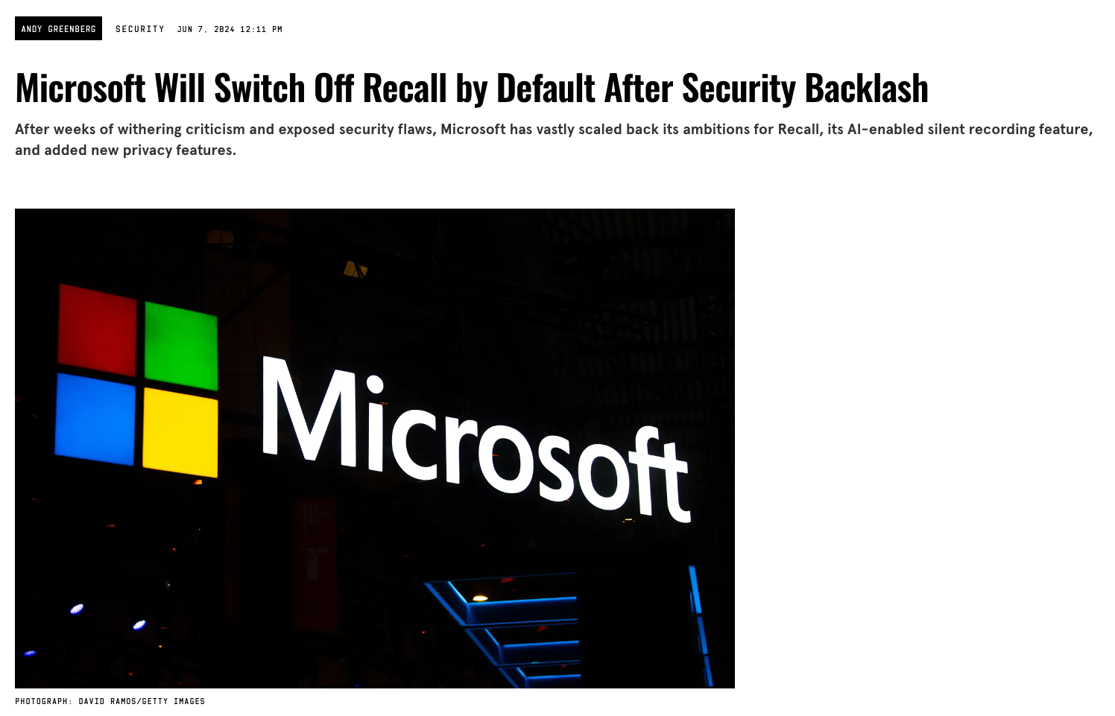
The AI Business Gold Rush

Slide 33
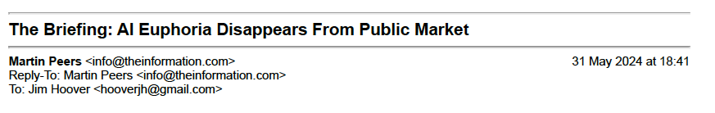
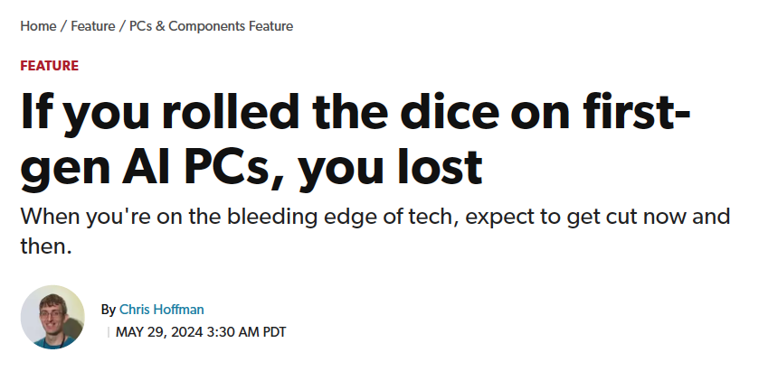
The AI Business Gold Rush

Slide 34
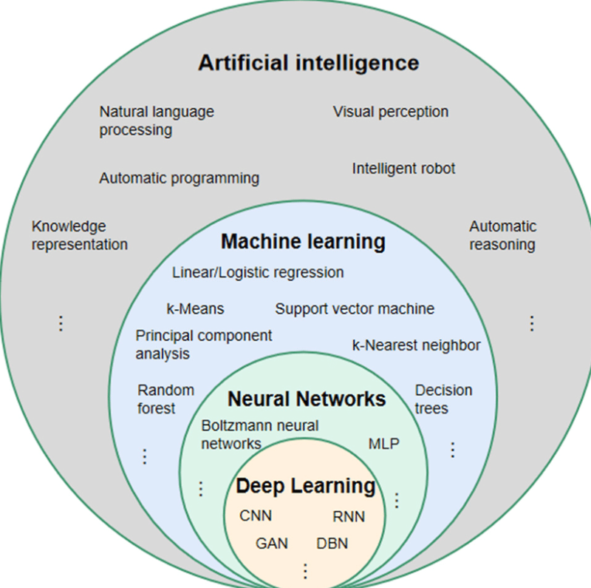
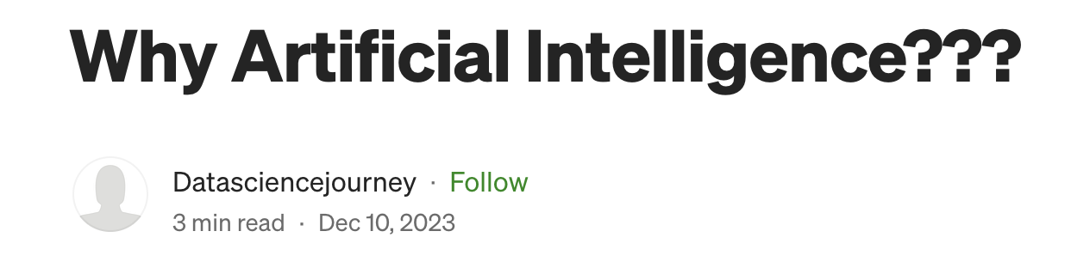
What Is AI?
Hyperlink

Slide 35
Major Machine Learning Types
Machine Learning Tasks – 3 major types:
Supervised learning – Humans provide labels to data related to the outcome of a task in order to “train” the computer algorithm
Unsupervised learning – The computer doesn’t receive labels from humans, but looks to find “structure” in the input data. This can be the first step in labeling the data for further supervised learning.
Reinforcement learning – The computer interacts with the environment and data from the environment to reward or penalize algorithms as it is exposed to more data (or scenarios). Example – cars under varying conditions like speed, cornering, acceleration, etc.

Slide 36
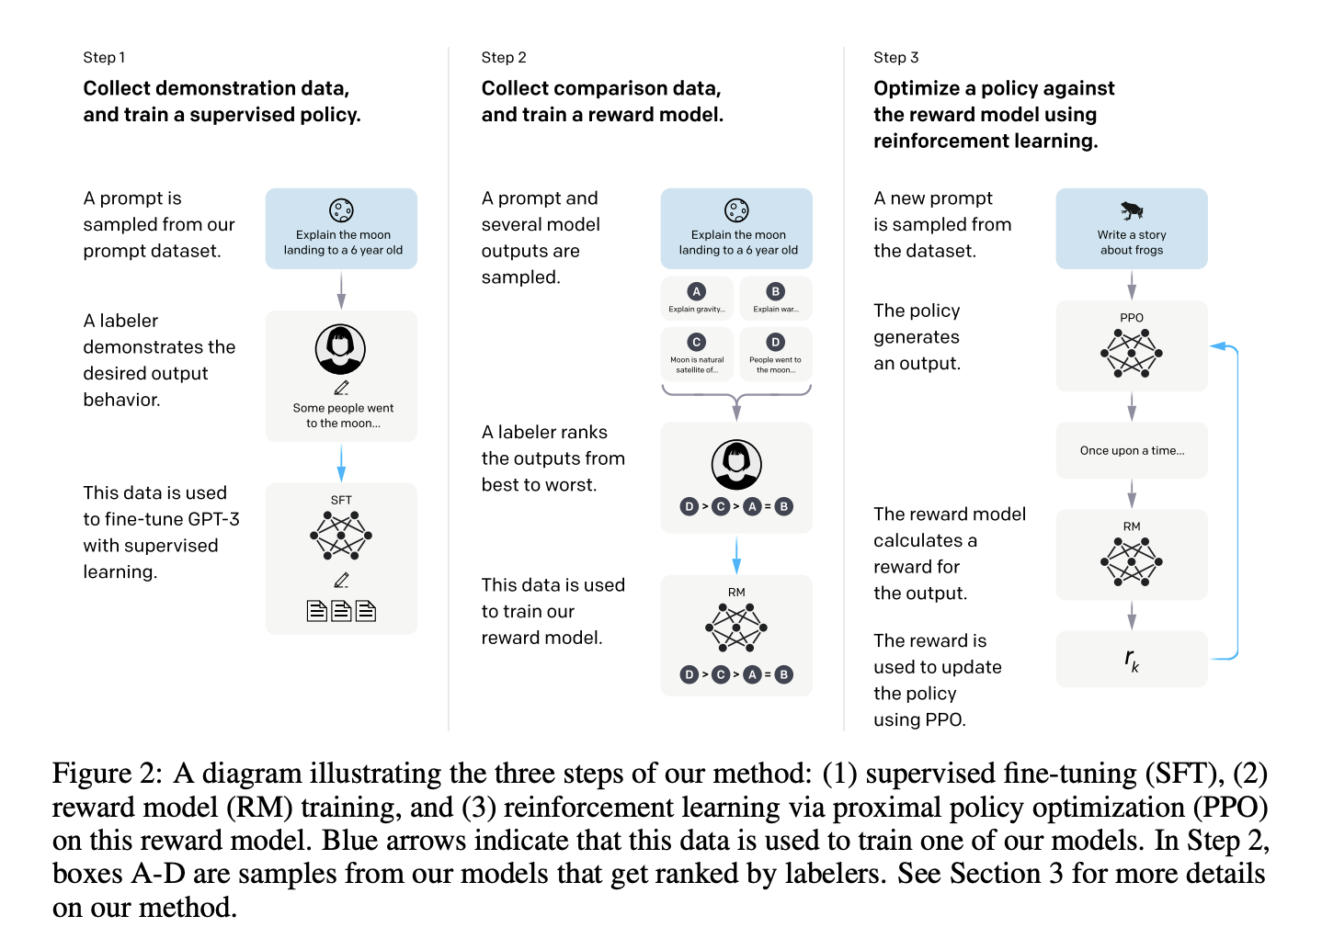
Generative AI – Reinforcement Learning (RLHF)
Hyperlink to image source – OpenAI paper

Slide 37
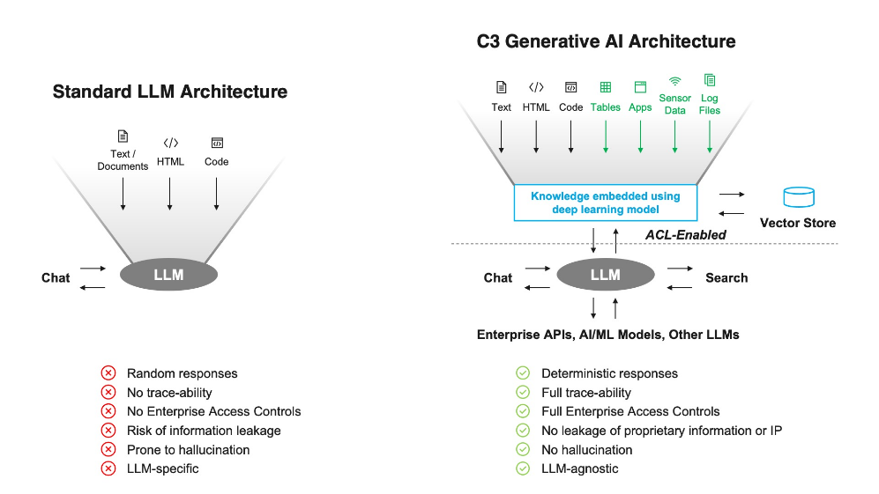
Mitigating Risks – c3.ai example
Hyperlink to image source – c3.ai

Slide 38
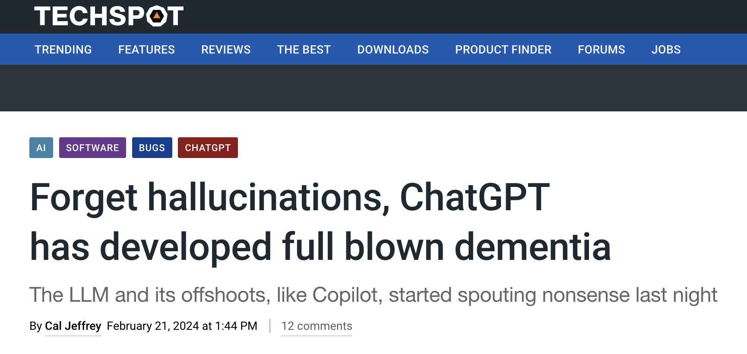
Mitigating Risks – Dementia
Hyperlink to image source – Techspot

